Slide 1
Supervised Learning
Linear Regression
Notes:
Unit 3: Supervised Learning
Module 1: Linear Regression

Slide 2


Objective
Objective
Objective
Define the set-up of Supervised Learning
Discuss basic regression models
Notes:
Module 1: Defining the setup. Discuss the regression task in Supervised Learning)

Slide 3
Supervised Learning
The set-up: the given training data consist of <sample, label> pairs, or (x, y); the objective of learning is to figure out a way to predict label y for any new sample x.
Consider two types of problems:
Regression: y continuous
Classification: y is discrete, e.g., class labels.
Notes:
Provide an example during lecture.

Slide 4
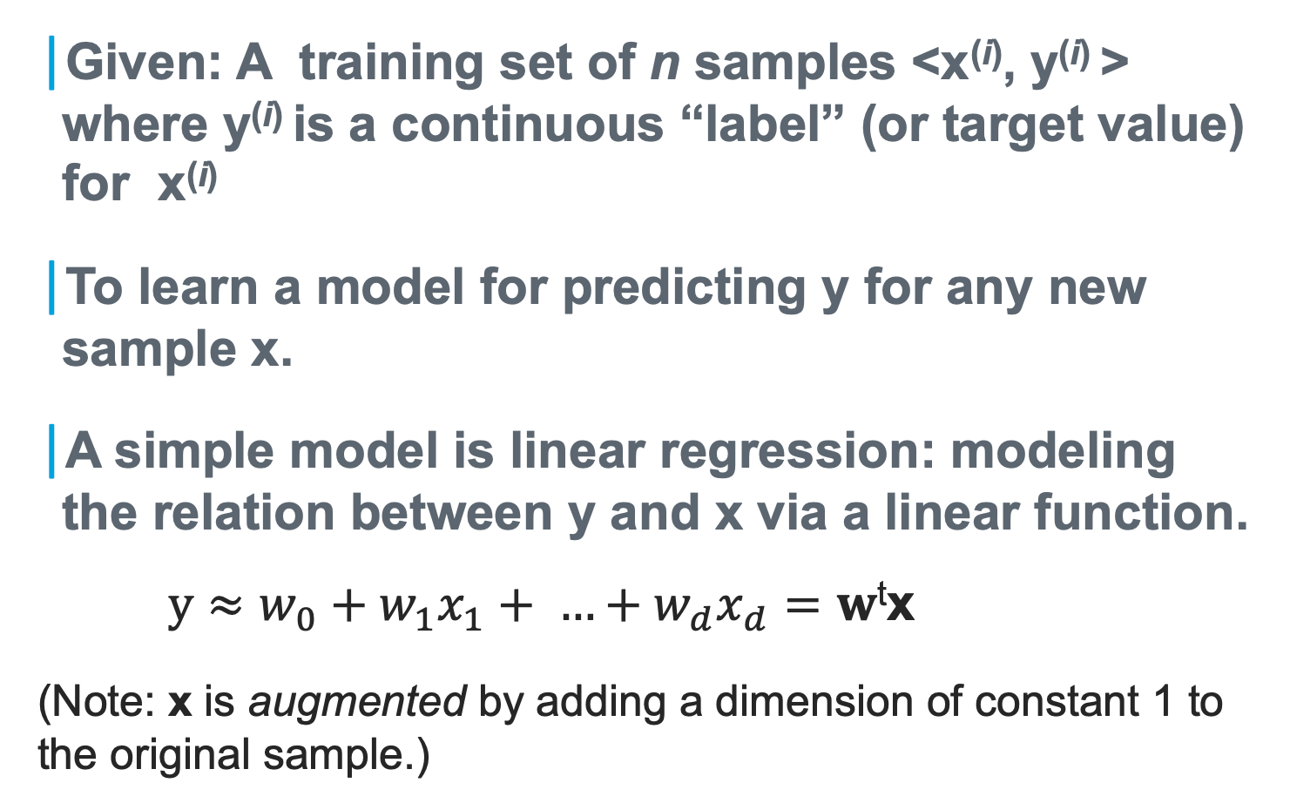
The Task of Regression
Given: A training set of n samples <x^{(i)}, y^{(i)} > where y^{(i)} is a continuous “label” (or target value) for x^{(i)}
To learn a model for predicting y for any new sample x.
A simple model is linear regression: modeling the relation between y and x via a linear function.
$y≈w_{0}+w_{1}x_{1}+ …+w_{d}x_{d}=w$^{t}x
(Note: x is augmented by adding a dimension of constant 1 to the original sample.)

Slide 5
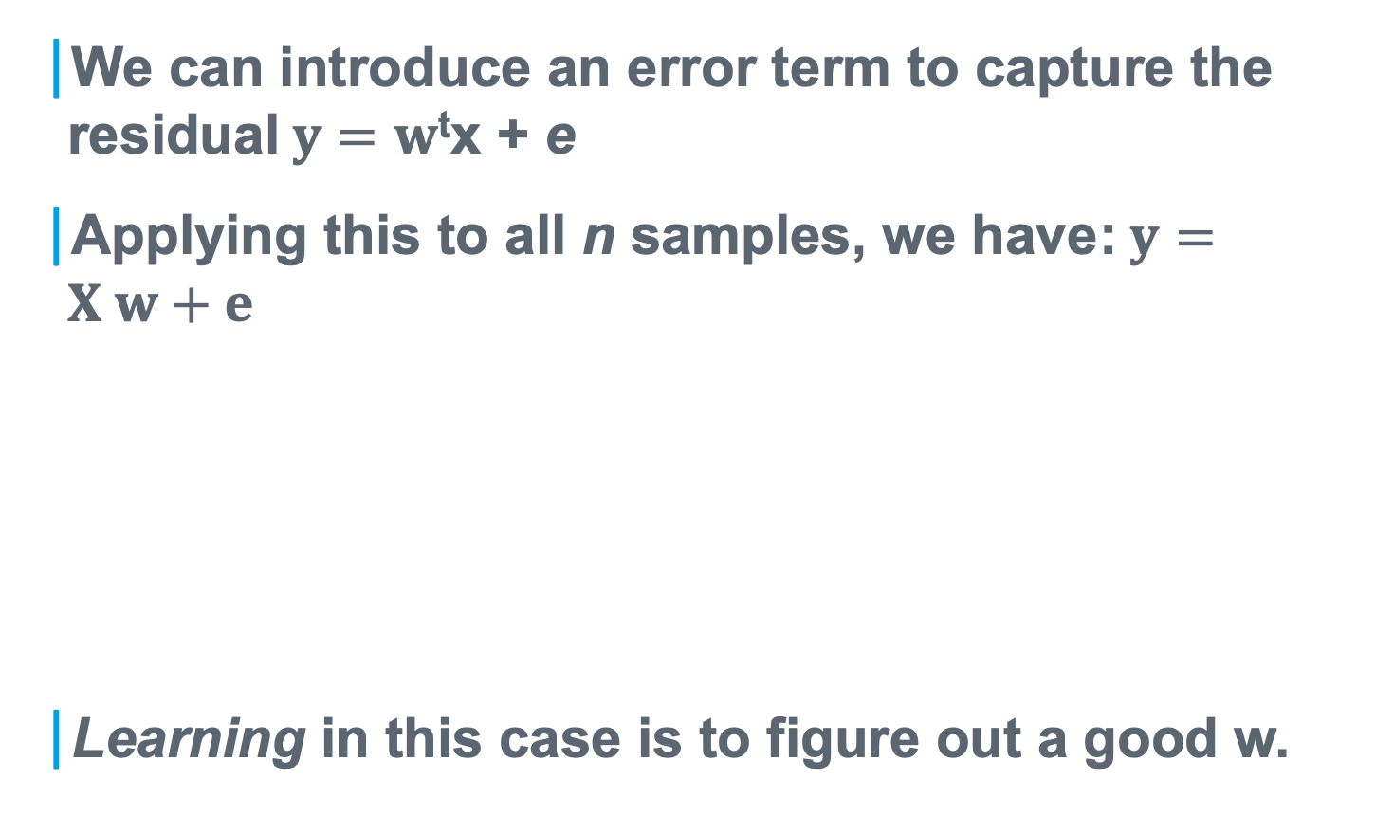
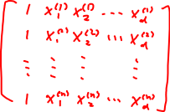


Linear Regression
We can introduce an error term to capture the residual$y=w$^{t}x + e
Applying this to all n samples, we have:$y=X w+e$
Learning in this case is to figure out a good w.
Notes:
Provide an example during lecture.

Slide 6
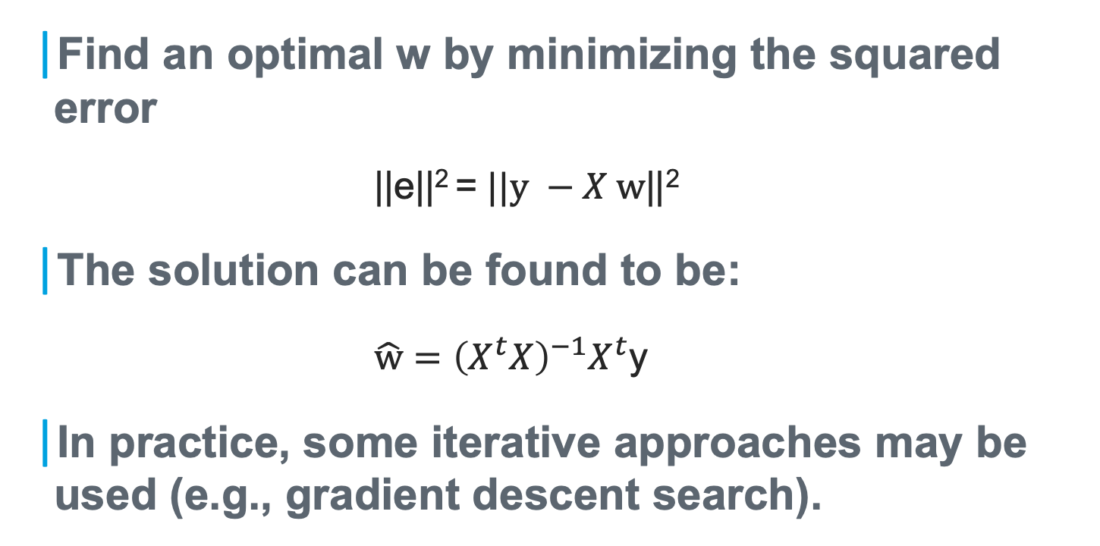
Linear Regression (cont’d)
Find an optimal w by minimizing the squared error
||e||² =$||y −X w$||²
The solution can be found to be:
$\hat{w}={\left(X^{t}X\right)}^{−1}X^{t}$y
In practice, some iterative approaches may be used (e.g., gradient descent search).

Slide 7
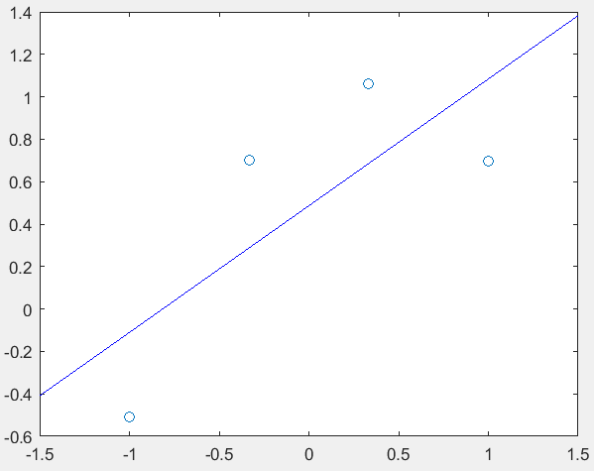
A simple example

Slide 8
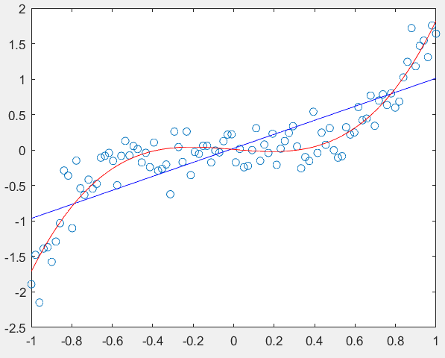
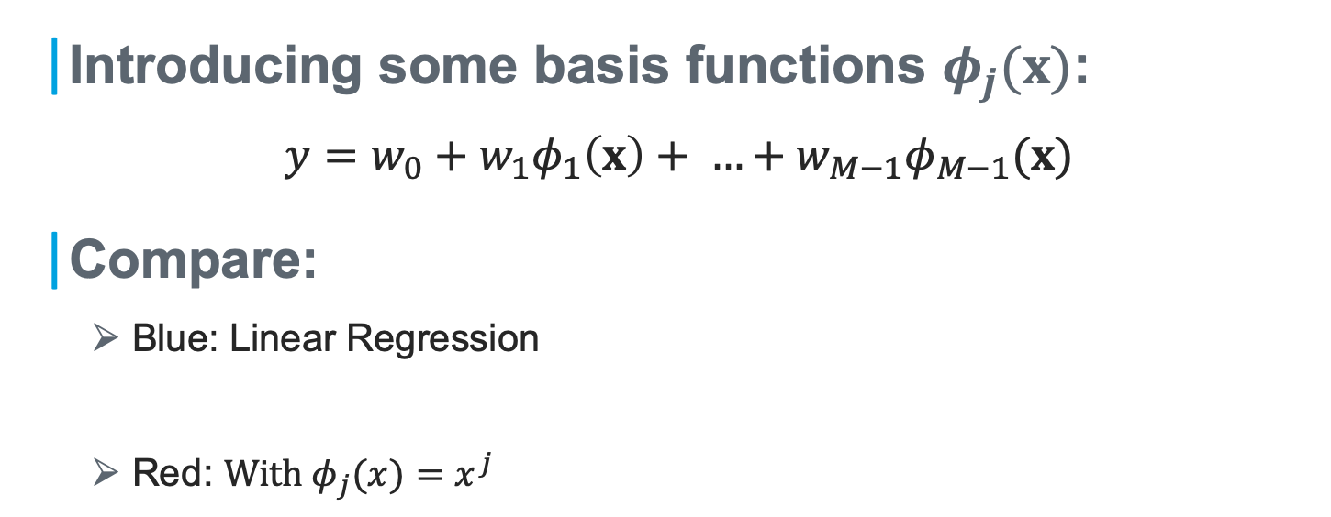
Generalizing Linear Regression
Introducing some basis functions $φ_{j}(x)$:
$$y=w_{0}+w_{1}φ_{1}\left(x\right)+ …+w_{M−1}φ_{M−1}(x)$$
Compare:
Blue: Linear Regression
Red: $With φ_{j}(x)=x^{j}$
Notes:
There are other basis function choices, like Gaussian, sigmoid, etc.

Slide 9
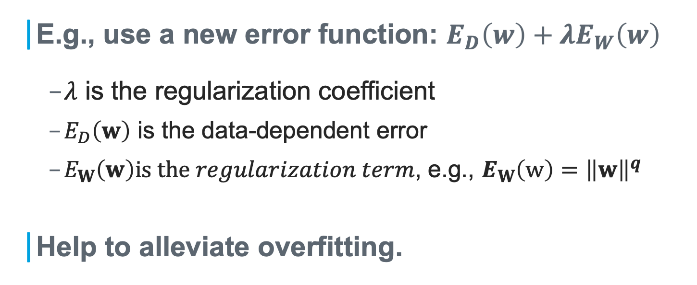
Regularized Least Squares
E.g., use a new error function: $E_{D}\left(w\right)+λE_{W}\left(w\right)$
$λ$ is the regularization coefficient
$E_{D}\left(w\right)$ is the data-dependent error
$E_{W}\left(w\right)is the regularization term$, e.g., $E_{W}\left(w\right)={\left\|w\right\|}^{q}$
Help to alleviate overfitting.

Slide 11
Supervised Learning
Density Estimation in Supervised Learning
Notes:
Unit 3: Supervised Learning
Module 2:

Slide 12
Objective
Objective
Objective
Illustrate classification in Supervised Learning
Discuss basic density estimation techniques
Notes:
Unit 3: Supervised Learning
Module 2: Classification Task; Density estimation.

Slide 13
Supervised Learning
The set-up: the given training data consist of <sample, label> pairs, or (x, y); the objective of learning is to figure out a way to predict label y for any new sample x.
Consider two types of problems:
Regression: y continuous
Classification: y is discrete, e.g., class labels.

Slide 14
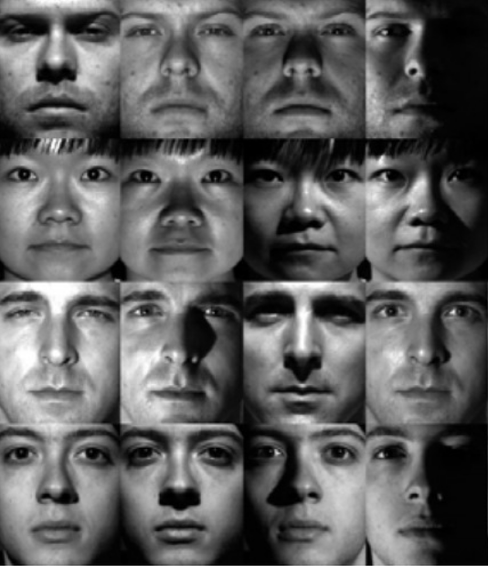
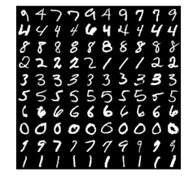
Examples of Image Classification
The MNIST training images of hand-written digits
The Extended Yale B Face Images

Slide 15
How do we model the training images?
Parametric: each class of images (the feature vectors) may be modeled by a density function p_{θ}(x) with parameter θ.
To emphasize the density is for images from class/label y, we may write p_{θ}(x|y).
We may also use the notation p(x|θ), if the discussion is true for any y.
➔ How to estimate θ from the training images?
Note: We may also consider non-parametric approaches.

Slide 16
MLE for Density Estimation (1/3)
Given some training data; Assuming a parametric model p(x|θ); What specific θ will fit/explain the data best?
E.g., Consider a simple 1-D normal density with only a parameter µ (assuming the variance is known)
Given a sample x_{i}, p(x_{i} | µ) gives an indication of how likely x_{i} is from p(x_{i} |µ)
➔the concept of the likelihood function.
x
x
x
x
x
x
x
x
x
x
x

Slide 17

MLE for Density Estimation (2/3)
The likelihood function: the density function p(x|θ) evaluated at the given data sample x_{i}, and viewed as a function of the parameter θ.
Assessing how likely the parameter θ (defining the corresponding p(x|θ)) gives arise to the sample x_{i}.
We often use L(θ) to denote the likelihood function, and l(θ) = log(L(θ)) is called the log-likelihood.
Maximum Likelihood Estimation (MLE): Finding the parameter that maximizes the likelihood function
$$\hat{θ}={\text{argmax}}_{θ}\text{p}\text{(}\text{x}\text{|}\text{θ}\text{)}$$

Slide 18

MLE for Density Estimation (3/3)
How to consider all the given samples D={x_{i}, i=1,…,n} ?
The concept of i.i.d. samples: the samples are assumed to be independent and identically distributed
So, the data likelihood is given by
$$L\left(θ\right)=P\left(D | θ\right)=$$

Slide 19
MLE Example 1
Tossing a coin for n times, observing n₁ times for head.
Estimate the probability θ for head
The likelihood function is:
$$L\left(θ\right)=P\left(D | θ\right)=θ^{n_{1}}{\left(1−θ\right)}^{n−n_{1}}$$

Slide 20
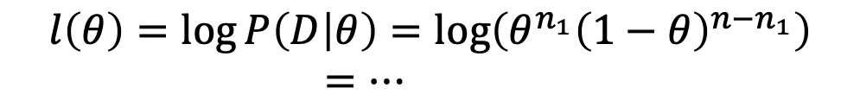


MLE Example 1 (cont’d)
We want to find what θ maximizes this likelihood, or equivalently, the log-likelihood
Take the derivative and set to 0:
This will give us:
$$l\left(θ\right)=\log{P\left(D | θ\right)}=\log\left(θ^{n_{1}}{\left(1−θ\right)}^{n−n_{1}}\right)$$
$=…$
$$\frac{d}{dθ}l\left(θ\right)=0$$
$$\hat{θ}=\frac{n_{1}}{n}$$

Slide 21
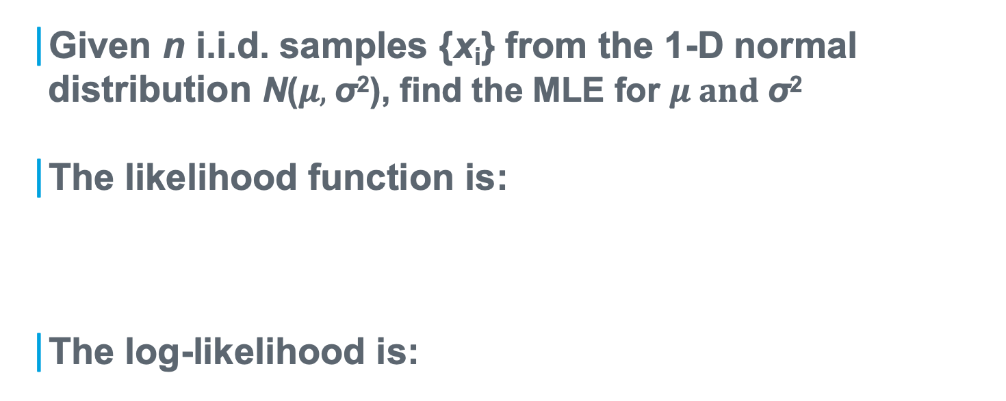
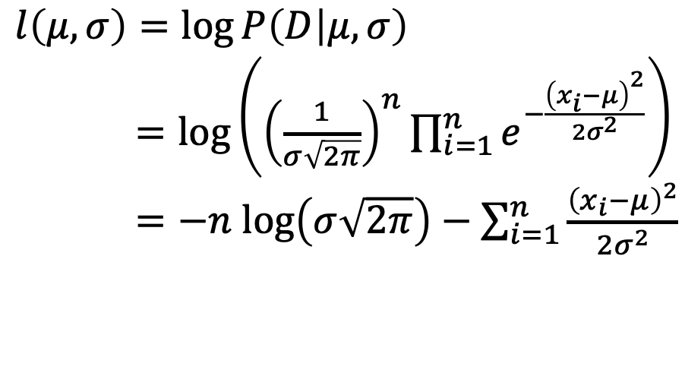
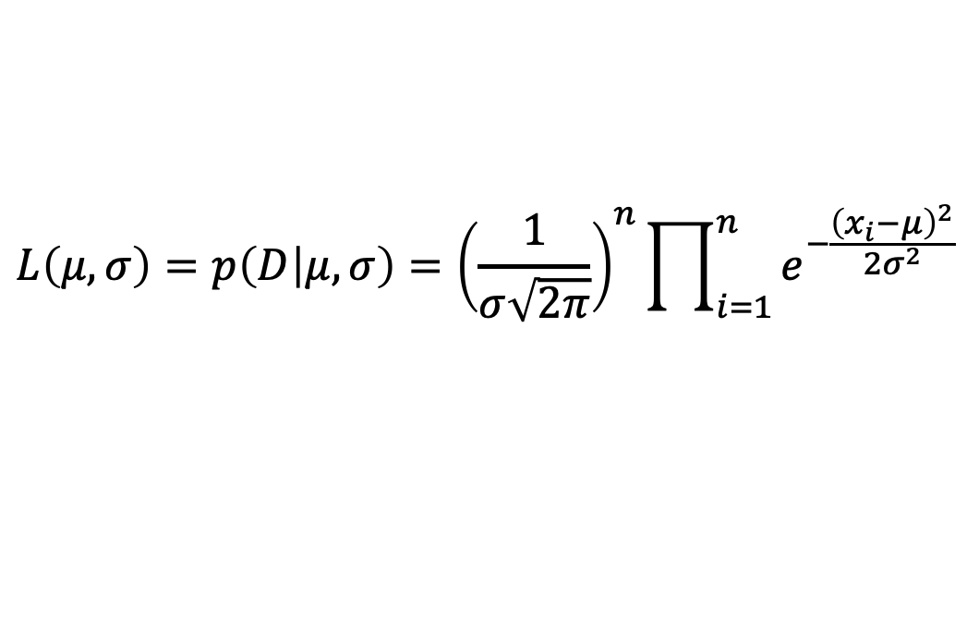
MLE Example 2
Given n i.i.d. samples {x_{i}} from the 1-D normal distribution N($μ,$σ²), find the MLE for $μ and$σ²
The likelihood function is:
The log-likelihood is:
$$L\left(μ,σ\right)=p\left(D | μ,σ\right)={\left(\frac{1}{σ\sqrt{2π}}\right)}^{n}\prod_{i=1}^{n}{e^{−\frac{{\left(x_{i}−μ\right)}^{2}}{2σ^{2}}}}$$
$$l\left(μ,σ\right)=\log{P\left(D | μ,σ\right)}$$
$=\text{log}\left({\left(\frac{1}{σ\sqrt{2π}}\right)}^{n}\prod_{i=1}^{n}{e^{−\frac{{\left(x_{i}−μ\right)}^{2}}{2σ^{2}}}}\right)$
$=−n \text{log}\left(σ\sqrt{2π}\right)−\sum_{i=1}^{n}{\frac{{\left(x_{i}−μ\right)}^{2}}{2σ^{2}}}$

Slide 22
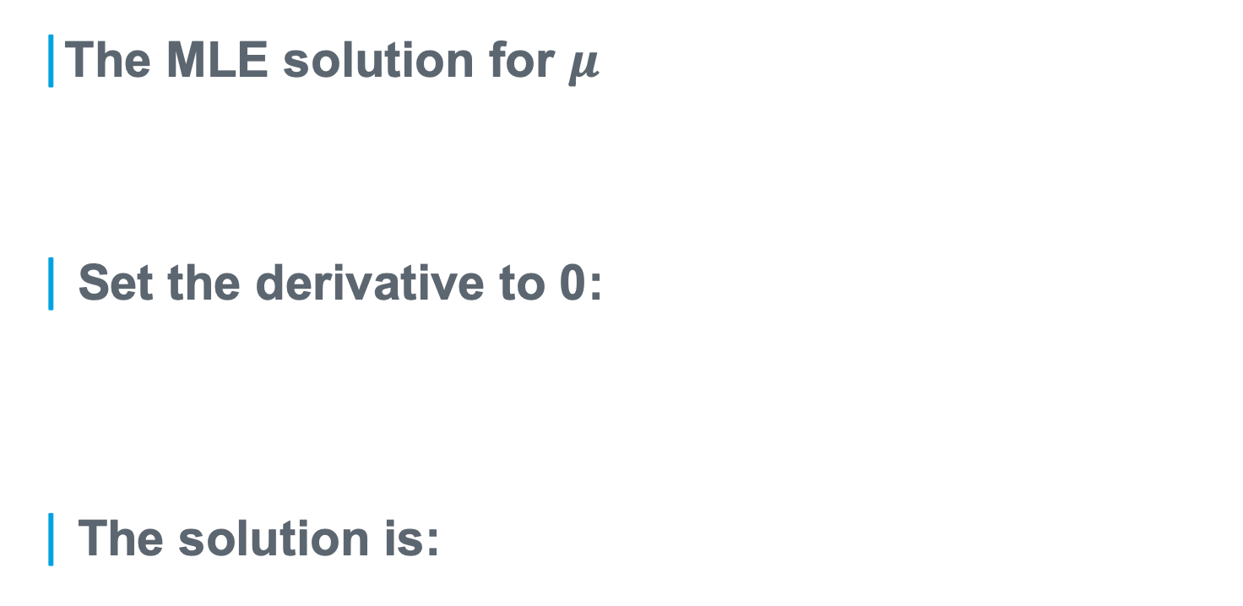
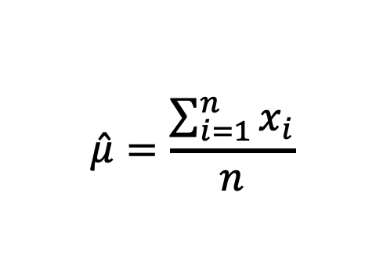
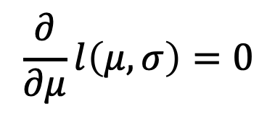
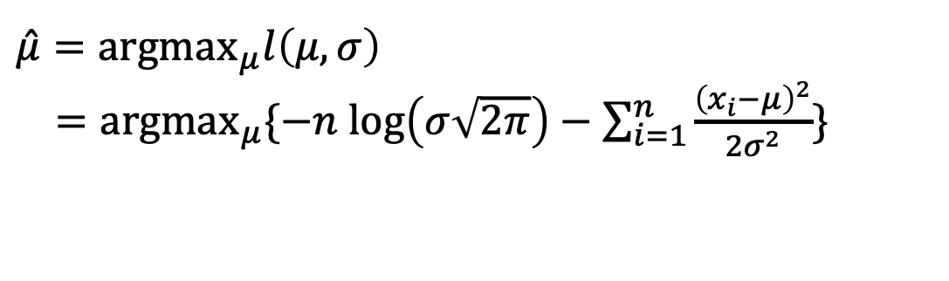
MLE Example 2 (cont’d)
The MLE solution for $μ$
Set the derivative to 0:
The solution is:
$$\hat{μ}={\text{argmax}}_{μ}l\left(μ,σ\right)$$
$={\text{argmax}}_{μ}\{−n \text{log}\left(σ\sqrt{2π}\right)−\sum_{i=1}^{n}{\frac{{\left(x_{i}−μ\right)}^{2}}{2σ^{2}}\}}$
$$\frac{∂}{∂μ}l\left(μ,σ\right)=0$$
$$\hat{μ}=\frac{\sum_{i=1}^{n}{x_{i}}}{n}$$

Slide 23
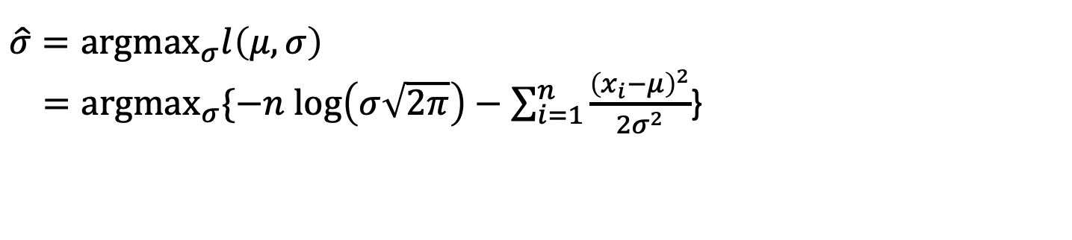
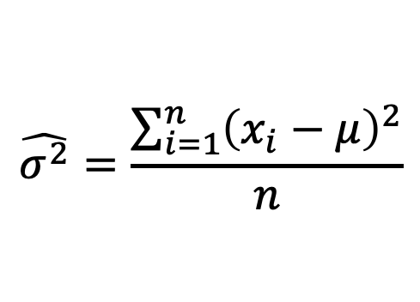
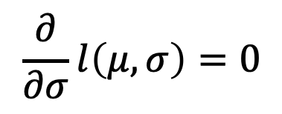
MLE Example 2 (cont’d)
The MLE solution for $μ$
Set the derivative to 0:
The solution is:
$$\hat{σ}={\text{argmax}}_{σ}l\left(μ,σ\right)$$
$={\text{argmax}}_{σ}\{−n \text{log}\left(σ\sqrt{2π}\right)−\sum_{i=1}^{n}{\frac{{\left(x_{i}−μ\right)}^{2}}{2σ^{2}}}$}
$$\frac{∂}{∂σ}l\left(μ,σ\right)=0$$
$$\hat{σ^{2}}=\frac{\sum_{i=1}^{n}{{\left(x_{i}−μ\right)}^{2}}}{n}$$

Slide 25
Supervised Learning
Generative vs Discriminative Models in Supervised Learning
Notes:
Unit 3: Supervised Learning
Module 3: Generative vs Discriminative Model of Supervised Learning

Slide 26
Objective
Objective
Objective
Differentiate between generative and discriminative models of supervised learning
Discuss challenges in Bayesian learning
Notes:
Unit 3: Supervised Learning
Module 3: Generative & discriminative models & examples

Slide 27
Supervised Learning
The set-up: the given training data consist of <sample, label> pairs, or (x, y); the objective of learning is to figure out a way to predict label y for any new sample x.
E.g., Given n pairs <x^{(i)}, y^{(i)} >, i=1, …, n; x^{(i)} : i-th sample represented as d-dimensional vectors; y^{(i)} : corresponding labels.
Equivalently, to find P(y|x)

Slide 28
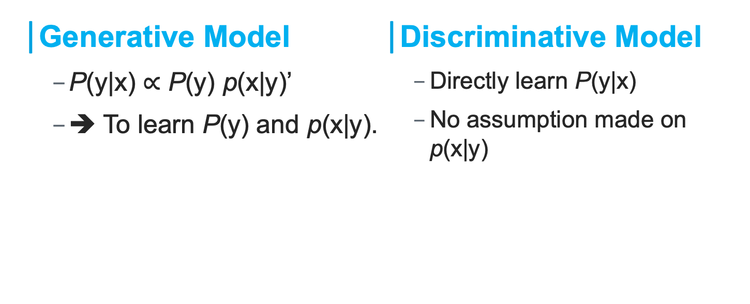
Two Types of Models
Generative Model
P(y|x) $∝$ P(y) p(x|y)’
➔ To learn P(y) and p(x|y).
Discriminative Model
Directly learn P(y|x)
No assumption made on p(x|y)

Slide 29
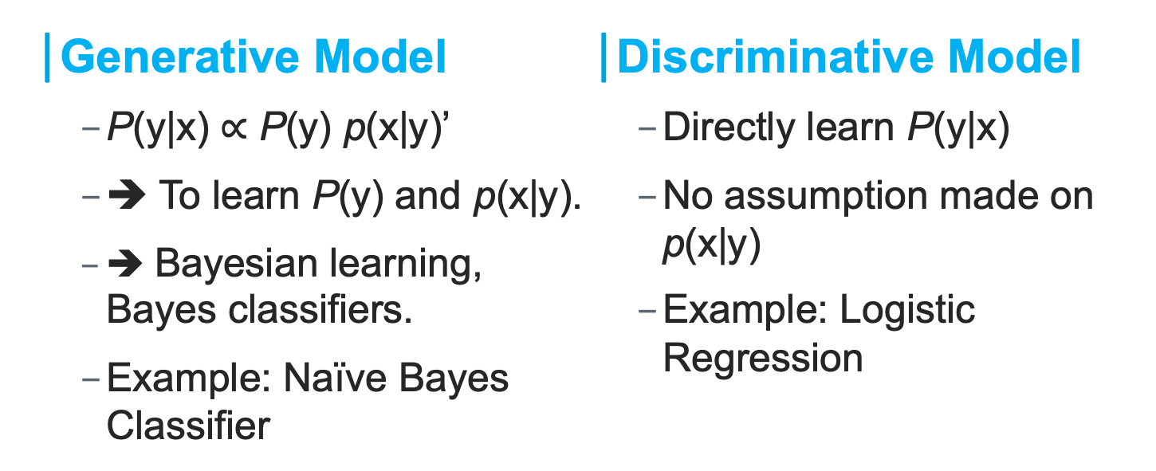
Two Types of Models
Generative Model
P(y|x) $∝$ P(y) p(x|y)’
➔ To learn P(y) and p(x|y).
➔ Bayesian learning, Bayes classifiers.
Example: Naïve Bayes Classifier
Discriminative Model
Directly learn P(y|x)
No assumption made on p(x|y)
Example: Logistic Regression

Slide 30
Practical Difficulty of Bayesian Learning
Consider doing Bayesian learning without making simplifying assumptions.
Given n training pairs <x^{(i)}, y^{(i)} >, i=1, …, n. Each x^{(i)} is d-dimensional.
We need to learn P(y) and p(x|y)
➔ p(x|y) can be very difficult to estimate:
➔ Consider a very simple case: binary features, and y is also binary. How many probabilities do we need to estimate?
Notes:
Generative models seem to be powerful: being able to generate the data!
But, … practical difficulties.

Slide 31
Supervised Learning
Naïve Bayes Classifier
Notes:
Unit 3: Supervised Learning
Module 4: Naïve Bayes Classifier

Slide 32
Objective
Objective
Implement the fundamental learning algorithm Naive Bayes

Slide 33
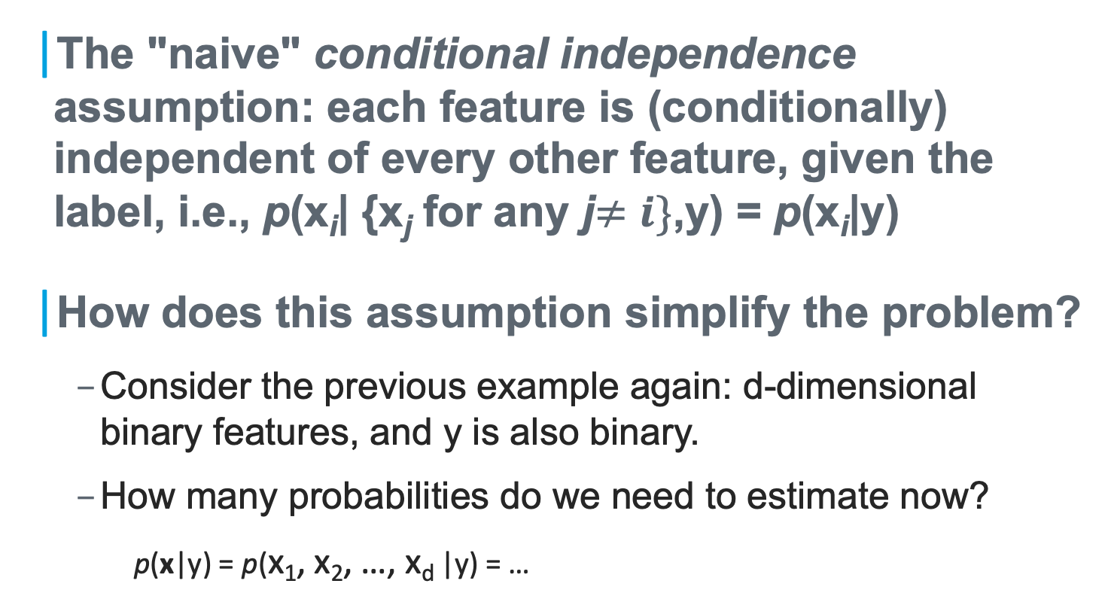
Naïve Bayesian Classifier
The "naive" conditional independence assumption: each feature is (conditionally) independent of every other feature, given the label, i.e., p(x_{i}| {x_{j} for any j$≠i\}$,y) = p(x_{i}|y)
How does this assumption simplify the problem?
Consider the previous example again: d-dimensional binary features, and y is also binary.
How many probabilities do we need to estimate now?
p(x|y) = p(x₁, x₂, …, x_{d} |y) = …

Slide 34
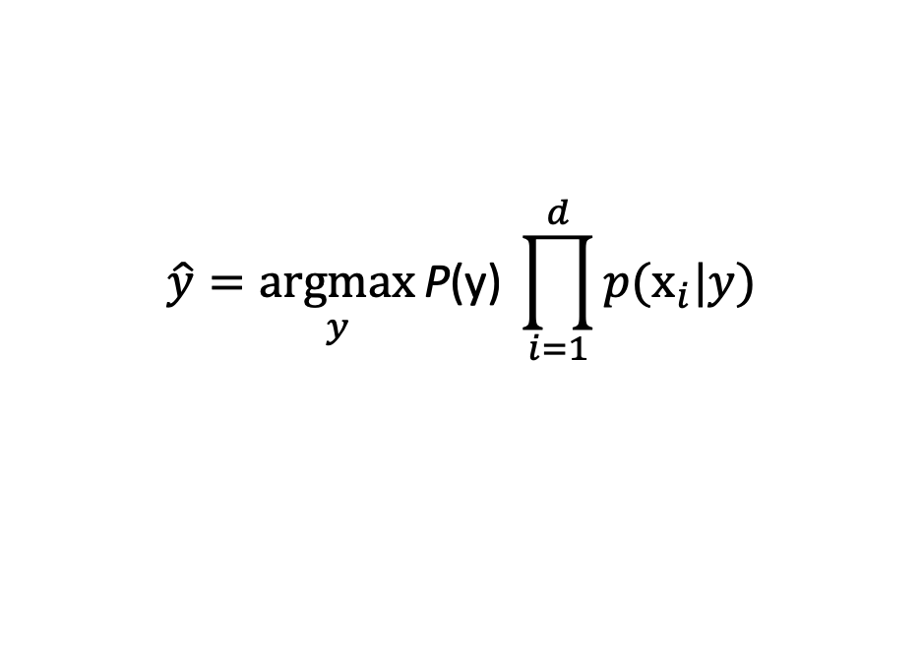
Naïve Bayesian Classifier (cont’d)
The naïve Bayes classifier: the predicted label is given by
“Parameters” of the classifier:
P(y)
p(x_{i} |y) for all i, y
$$\hat{y}=\underset{y}{argmax}{\text{P}\text{(}\text{y}\text{) }\prod_{i=1}^{d}{p(x_{i}|y)}}$$

Slide 35
Naïve Bayesian Classifier (cont’d)
E.g., estimating the “parameters” of the classifier
P(y) & p(x_{i} |y) for all i, y -
for the following familiar example

Slide 36
Discrete Feature Example
x = <x₁, x₂, …, x_{d}> where each x_{i} can take only a finite number of values from {v₁, v₂, …, v_{m}}:
In this case, the “parameters” of the classifier are
P(y)
P(x_{i} =v_{k}|y), for all i, k, and y
Given: A training set of n labelled samples <x^{(i)}, y^{(i)} >, i=1, …, n
➔ How to estimate the model parameters?

Slide 37
Discrete Feature Example (cont’d)
Given: A training set of n labelled samples <x^{(i)}, y^{(i)} >, i=1, …, n
➔ How to estimate the model parameters?
These are in fact the MLE solutions for the corresponding parameters.
P(y) =
P(x_{i} =v_{k}|y)=

Slide 38
Supervised Learning
Logistic Regression
Notes:
Unit 3: Supervised Learning
Module 5: Logistic Regression

Slide 39
Objective
Objective
Implement the fundamental learning algorithm Logistic Regression

Slide 40
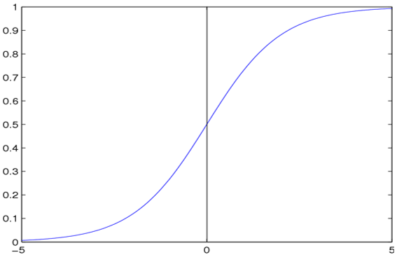
Discriminative Model: Example
Again, we are given a training set of n labelled samples <x^{(i)}, y^{(i)} >
Why not directly model/learn P(y|x)?
Discriminative model
Further assume P(y|x) takes the form of a logistic sigmoid function
→ Logistic Regression

Slide 41
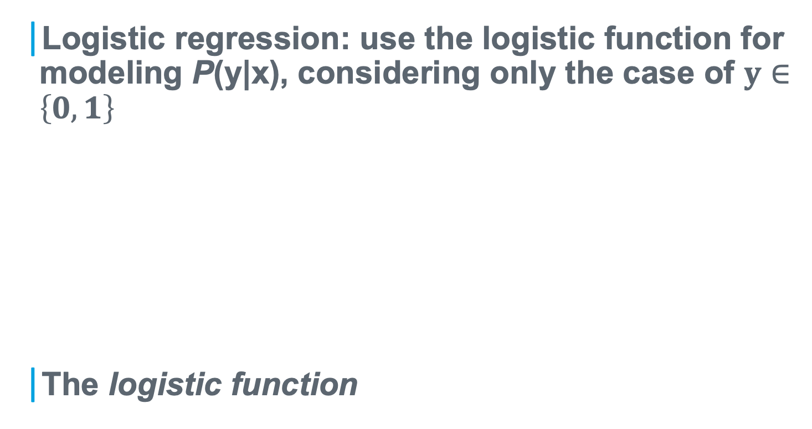

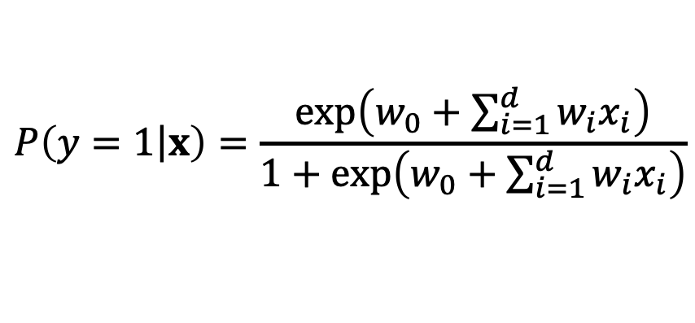
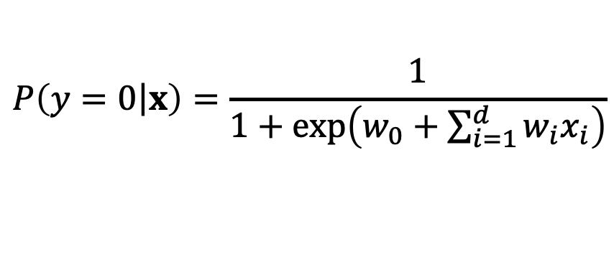
Logistic Regression
Logistic regression: use the logistic function for modeling P(y|x), considering only the case of $y∈\left\{0, 1\right\}$
The logistic function
$$P\left(y=0\left|x\right.\right)=\frac{1}{1+\text{exp}\left(w_{0}+\sum_{i=1}^{d}{w_{i}x_{i}}\right)}$$
$$P\left(y=1\left|x\right.\right)=\frac{\text{exp}\left(w_{0}+\sum_{i=1}^{d}{w_{i}x_{i}}\right)}{1+\text{exp}\left(w_{0}+\sum_{i=1}^{d}{w_{i}x_{i}}\right)}$$
$σ\left(t\right)=\frac{1}{1+e^{−t}}=\frac{e^{t}}{1+e^{t}}$

Slide 42
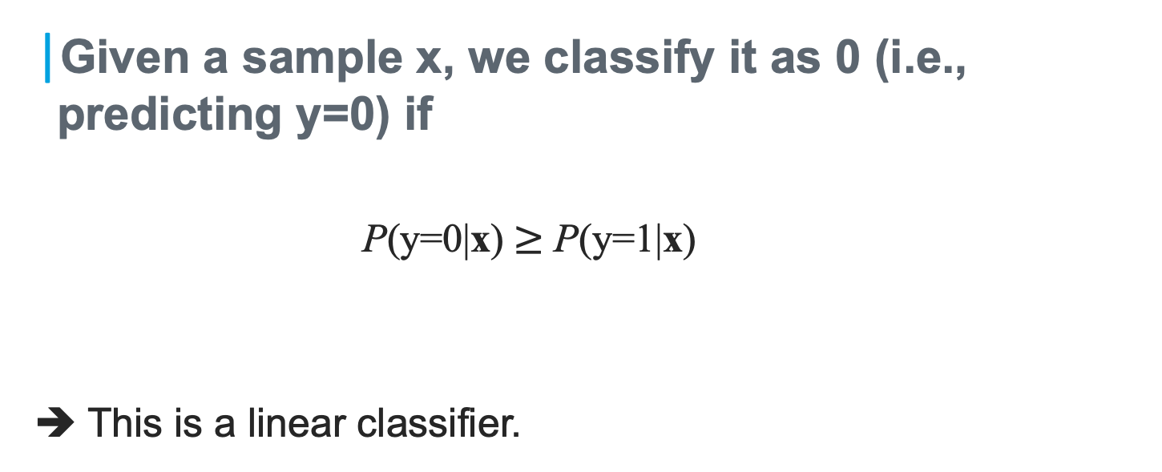
Logistic Regression → Linear Classifier
Given a sample x, we classify it as 0 (i.e., predicting y=0) if
P(y=0|x) $≥$ P(y=1|x)
➔ This is a linear classifier.

Slide 43

The Parameters of the Model
What are the model parameters in logistic regression?
Given a parameter w, we have P(y|x) =
Suppose we have two different sets of parameters, w⁽¹⁾ and w⁽²⁾, whichever giving a larger P(y|x) should be a better parameter.
Notes:
Conditional Likelihood
For estimating the parameters in logistic regression
Definition

Slide 44
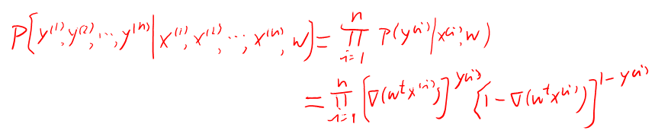
The Conditional Likelihood
Given n training samples, <x^{(i)}, y^{(i)} >, i=1,…,n, how can we use them to estimate the parameters?
➔ For a given w, the probability of getting all those y⁽¹⁾, y⁽²⁾ …,y^{(n)} from the corresponding data x^{(i)}, i=1,…,n, is
➔ Call this L(w), the (conditional) likelihood.
Notes:
Conditional Likelihood
For estimating the parameters in logistic regression
Definition

Slide 45
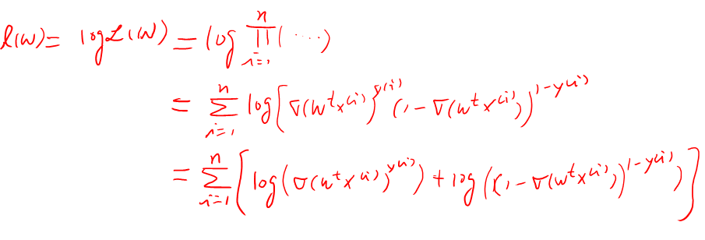
The Conditional Log Likelihood
Notes:
Conditional Likelihood
For estimating the parameters in logistic regression
Definition

Slide 46
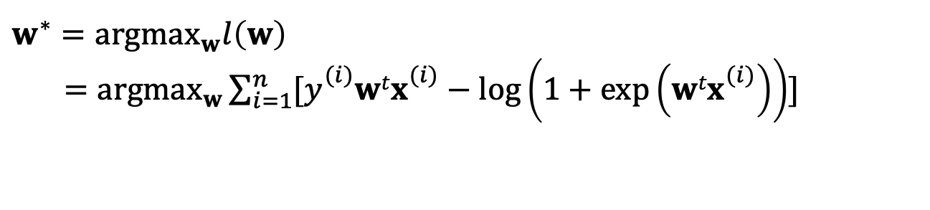
Maximizing Conditional Log Likelihood
Optimal parameters
We cannot really solve for w* analytically (no closed-form solution)
We can use a commonly-used optimization technique, gradient descent/ascent, to find a solution.
$$w^{∗}={\text{argmax}}_{w}l\left(w\right)$$
$={\text{argmax}}_{w}\sum_{i=1}^{n}{[y_{}^{(i)}wtx_{}^{(i)}−\text{log}\left(1+\text{exp}\left(wtx_{}^{(i)}\right)\right)]}$
Notes:
Properties of 𝑙(𝑤)
Concave with respect to 𝑤
No closed form solution for 𝑤∗
Optimization algorithm: gradient ascent

Slide 47
Finding the Gradient of l(w)
Notes:
Properties of 𝑙(𝑤)
Concave with respect to 𝑤
No closed form solution for 𝑤∗
Optimization algorithm: gradient ascent

Slide 48
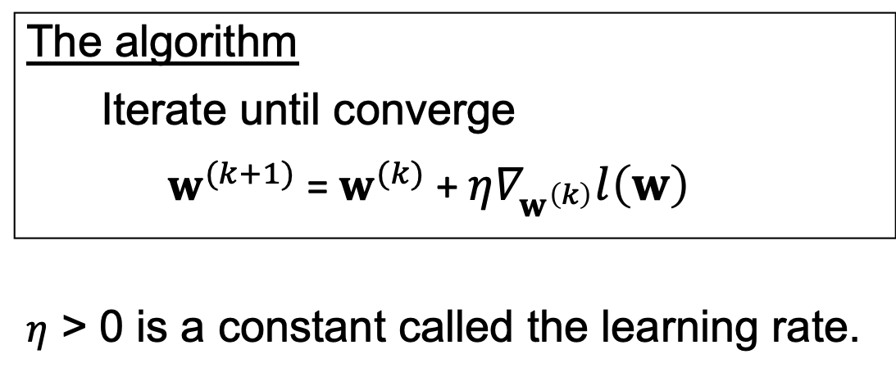
Gradient Ascent Algorithm
The algorithm
Iterate until converge
$w^{(k+1)}$ = $w^{(k)}$ + $η∇_{w^{\left(k\right)}}l\left(w\right)$
$η$ > 0 is a constant called the learning rate.

